Slide 1
Finance Management System
Case Study and
Project Development

Slide 2
Project Overview
The Finance Management System is designed to help individuals track and manage their personal finances through efficient recordkeeping and categorized expense management.
The project applies object-oriented programming (OOP), SQL database connectivity, exception handling, and unit testing to demonstrate real-world software development concepts.
Users can register, log in, add expenses, view categorized reports, and perform CRUD operations in a secure and structured environment.

Slide 3
Objectives
This system will allow users to:
Register and log in securely.
Add, update, delete, and view their expenses.
Categorize expenses into various types (Food, Travel, Utilities, etc.).
Generate reports of expenses by user and time period.
Persist data in a SQL-based database with proper relational design.
Maintain proper exception handling and unit testing.

Slide 4
Technologies Used
Technologies Used
Technology | Purpose
Python 3.x | Core programming language
MySQL | Relational database for storage
MySQL Connector | Python package for DB interaction
unittest / pytest | Testing framework
GitHub | Version control and submission

Slide 5
Project Structure
Project Folders:
entity/ – Models for User, Expense, Category
dao/ – Service interfaces and implementations
exception/ – Custom exception classes
util/ – Database connectivity and property handling
app/ – Menudriven class

Slide 6
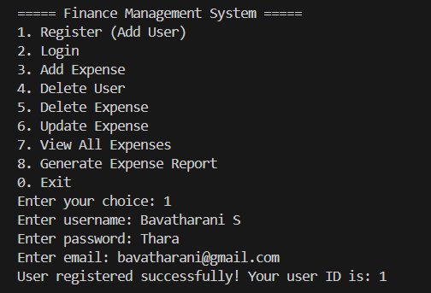
Functional Requirements
Users can register with a username, password, and email.

Slide 7
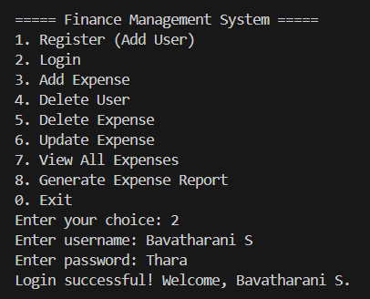
Functional Requirements
Users can log in securely to access their account.

Slide 8
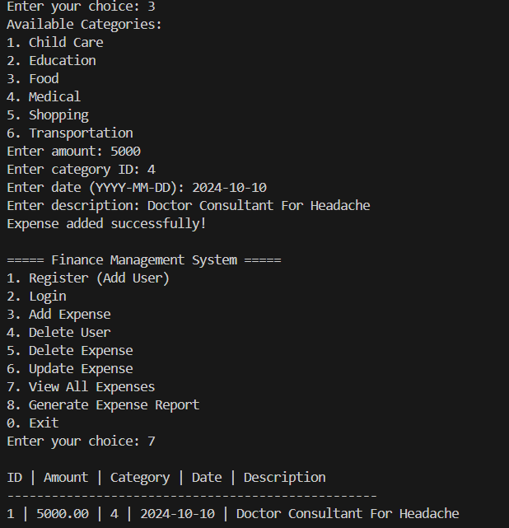
Functional Requirements
Add, update, delete, and view their expenses.

Slide 9
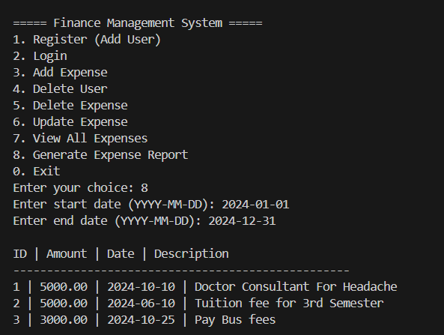
Functional Requirements
Generate reports of expenses by user and time period.

Slide 10
Exception Handling
UserNotFoundException - Raised when a user ID does not exist in the database.
ExpenseNotFoundException - Raised when an expense ID is invalid or missing.
These exceptions are defined in the exception/ package, raised from the DAO layer, and caught in the main driver program to ensure smooth, user-friendly error handling.

Slide 11
Unit Testing
Test User Creation Verifies that a user can be created successfully and inserted into the database.
Test Expense Creation Confirms that an expense record is added with valid details such as amount, date, and category.
Test Expense Retrieval Ensures all expenses linked to a particular user can be fetched from the database.
Test UserNotFoundException Checks that the system raises a UserNotFoundException when operations are attempted on a non-existent user ID.
Test ExpenseNotFoundException Validates that an ExpenseNotFoundException is triggered when trying to delete or retrieve an invalid expense ID.

Slide 12
Conclusion
The system allows users to securely register, log in, and manage their expenses by adding, updating, or deleting entries while categorizing them appropriately. With the inclusion of custom exception handling, it gracefully manages invalid user operations and system errors.
Unit testing has been implemented to validate the reliability and correctness of core functionalities such as user and expense management.

